Slide 1

Boston, MA User Summit: 2017
Secondary Title

Slide 2
Agenda
10:00 – 10:30 Meet & Greet / Coffee
10:30 – 11:00 Company News
11:00 - 11:30 Agile Training Champions Presentation
11:30 - 12:30 SpiraTeam Showcase
12:30 - 1:30 Lunch
1:30 – 2:00 SmarteSoft Presentation
2:00 - 2:30 SpiraTeam Roadmap
2:30 - 2:45 Coffee Break
2:45 – 3:15 Sophelle Presentation
3:15 - 3:45 Rapise Showcase & Roadmap
3:45 – 4:15 Open Forum Discussion
4:15 – 4:30 Feedback & Wrap Up

Slide 3
Company News
Secondary Title

Slide 4
The last few months
Big releases across our product line:
  SpiraTeam 5.2
  Rapise 5.0
  KronoDesk 2.0
  Updates to plugins (Excel, Jira)
  Open sourcing a number of plugins
New company strategy to make our tools better, faster
New initiatives (like today) to engage and help our customers beyond traditional support

Slide 5
Where do we want Inflectra to go next?
Accelerate growth (in response to user demand, not VC rounds)
Release updates across our product line on a consistent basis
Develop features faster that make our tools ever easier to use, and ever more powerful (it’s a tightrope)
Stay true to who we are and why we get up in the morning

Slide 6
Background – Who Are We?

Slide 7
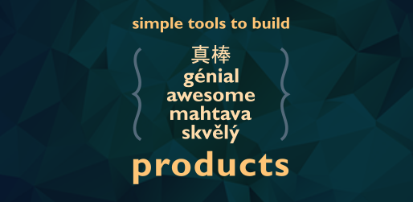
In a nutshell…

Slide 8
What does this mean for you?
We are focusing on three groups of people
Each release will balance how we can help each group, so everyone in your teams can get the most out of our products
Testers
Developers
Managers

Slide 9
What specific changes are we making?
Updating our marketing to emphasize the “why”
  Why is Inflectra different
  Why you use our products
Ensuring that we have a cohesive platform and ecosystem that supports our brand
Smaller releases to get new features out faster and respond more quickly to your feedback
Reaching out more proactively to our customers and potential customers
  We’ll discuss this more later…

Slide 10






Branding Changes
In late 2016 we brought in a new head of marketing to better communicate with our users.
We have a new brand and identity that is simpler and more cohesive across our products:

Slide 11
Nurturing the Inflectra Community
Sponsoring Local Meetups
  DC Agile Testing Community
  DC Coding Community
Inflectra User Summits
  Europe – March 2017
    London
    Zürich
    Germany
  North America
    Boston, MA – Today!
    San Francisco, CA – September 28th
  Future
    Let us know what you would like!

Slide 12

Getting Social with Inflectra
Website – Blog, Support Forums
Twitter – Latest News & Info
Facebook – News & Industry
LinkedIn – In Depth Coverage
Google+ - Industry & Background
YouTube – Product Videos
Pinterest – Diagrams and Infographics
Instagram – People & Events
XING – Company news for DACH region

Slide 13
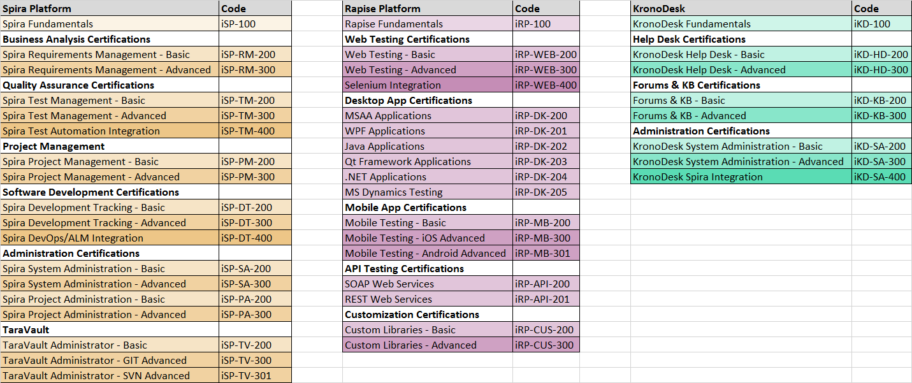
Training Initiatives
Developing curricula and training guides (see above)
Working w/ partners to create online courses using LMS
Free YouTube based videos for self-training

Slide 14
Demo of Velpic LMS Platform

Slide 15
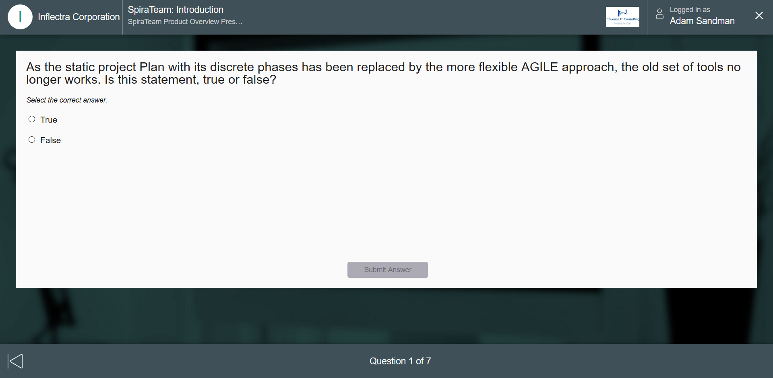
Screenshot of Velpic LMS

Slide 16

Agile Training Champions
Dr. Sriram Rajagopalan

Slide 17
Product Showcases

Slide 18
Overview: The Inflectra® Platform
KronoDesk®
IT Support & Help Desk Ticketing
SpiraTeam®
SpiraTest®
Requirements & Test Management
SpiraPlan®
Project Management & Defect Tracking
TaraVault™ - Source Code Hosting
Rapise®
Test Automation Platform (Web, GUI, Services)

Slide 19
SpiraTeam Show Case

Slide 20
SpiraTeam 5.2 Showcase
New incident list / detail page [Simon]
  Followers
  UI Updates
  Associations
  Graphs, maybe
Program planning board [Adam]
Testing things [Adam]
  Auto-suspect
  Test set auto-scheduling on build
Personalized dashboards for developers, testers and managers

Slide 21
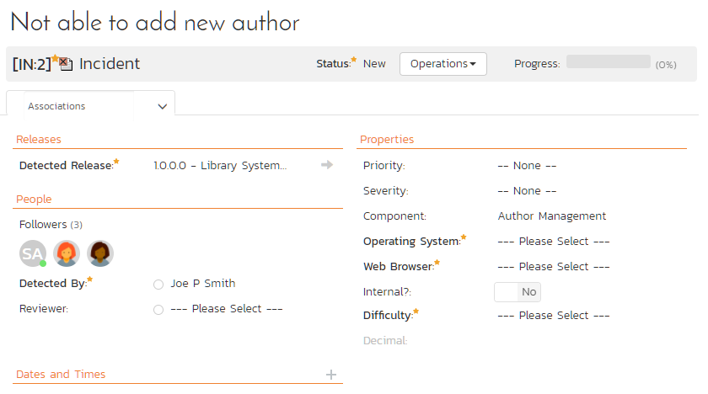

Slide 22
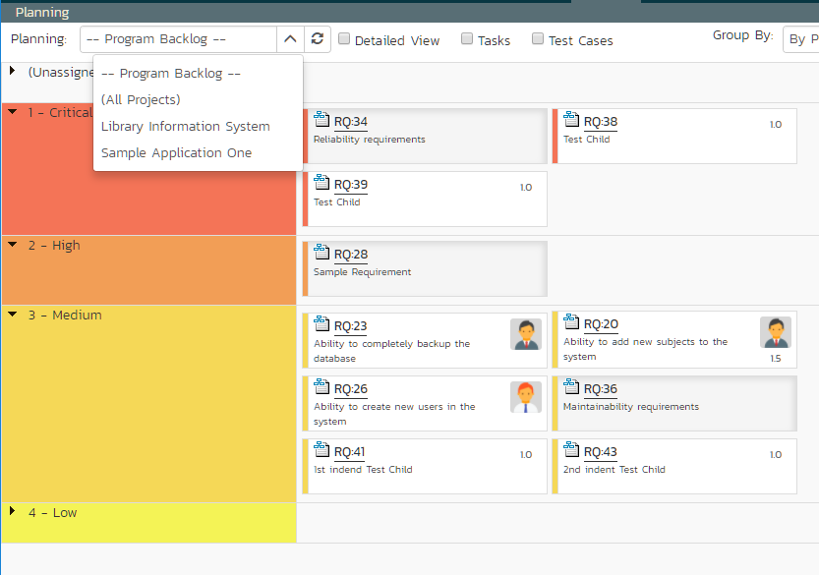

Slide 23
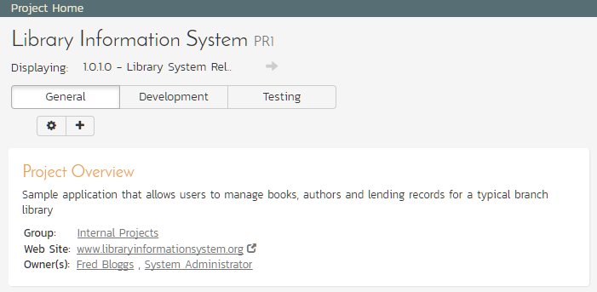

Slide 24
SpiraTeam 5.3 Showcase
We’d like to present concepts for the following two new features in v5.3:
  Exploratory Testing
  Test Configuration Management

Slide 25
SpiraTeam 5.3 – Exploratory Testing

Slide 26
SpiraTeam 5.3 – Test Configurations

Slide 27
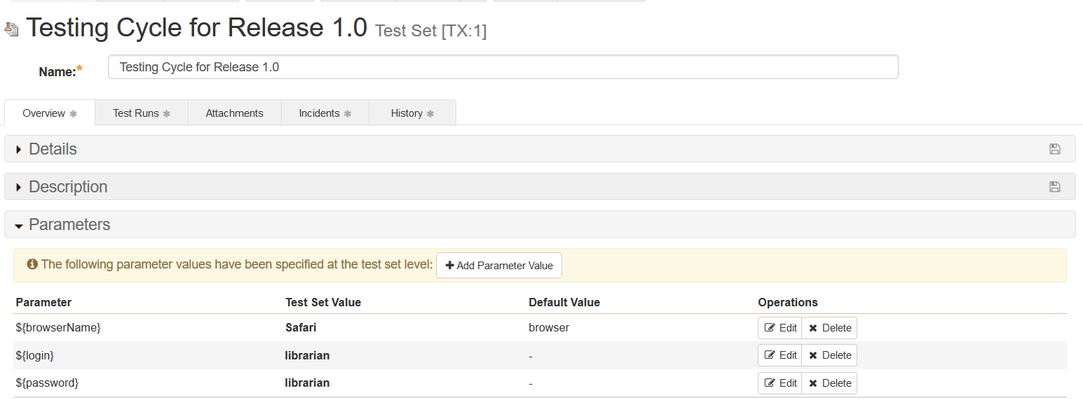
Test Configurations ? Why Do We Need Them?
We have a test set with some parameterized test cases:
We want to execute the same tests for multiple browsers and logins/passwords

Slide 28
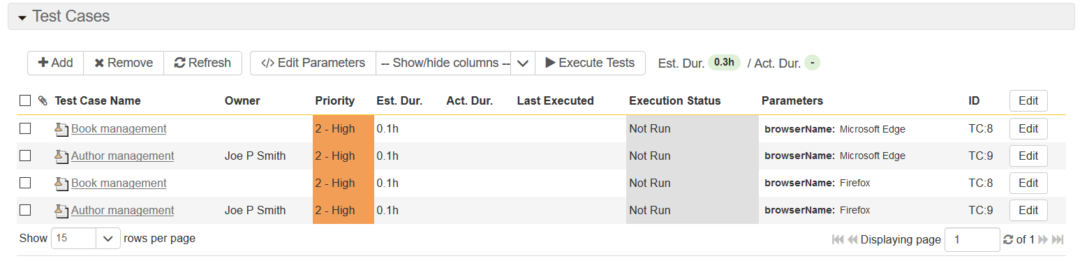
Test Configurations ? Why Do We Need Them?
We could add multiple instances of the same test case with different parameter values:
Or we could copy the same test set multiple times and set different values on the set.

Slide 29
Test Configurations ? Why Do We Need Them?
Imagine we have 5 browsers, 4 operating systems and 20 logins to test:
  That’s 1,600 unique test combinations!
  How do we easily exclude invalid combinations (Windows & Safari, Mac & IE)
Test configurations is a way to separate out the test data from the test sets and test cases.
So how might they work?

Slide 30
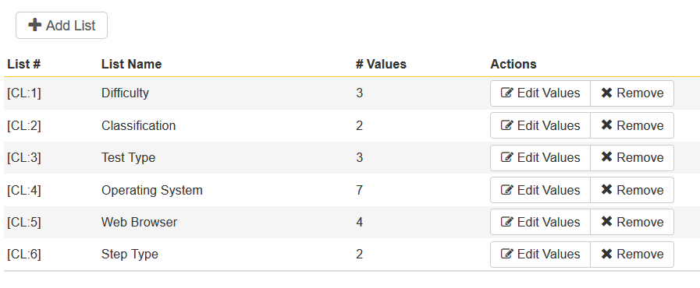
Test Configurations - Concept
You create a new test configuration:
  You map each of the test case parameters to a custom list that already exists:

Slide 31
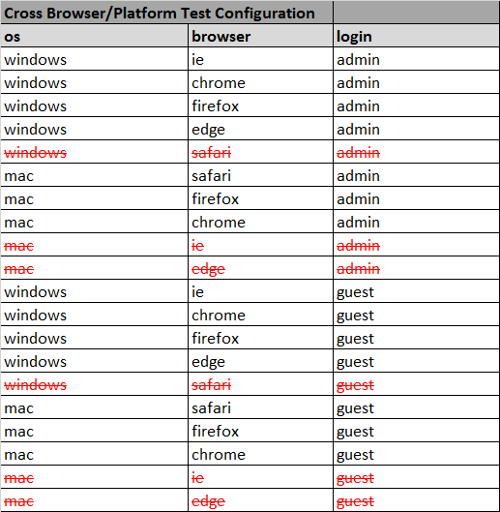
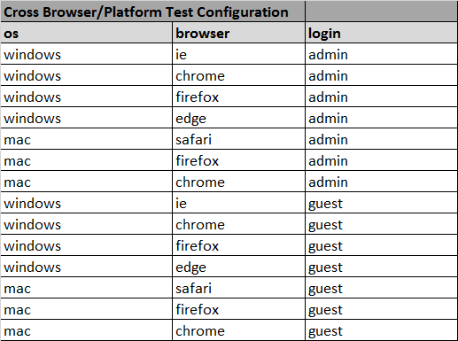
Test Configurations - Concept
The system auto-populates the table of all possible (but not necessarily valid) combinations:

Slide 32
Test Configurations - Concept
You can remove the combinations that are not valid (e.g. IE & Mac)
You then assign this test configuration to the test set and SpiraTest will then allow you to execute the entire set for each configuration.
  Could be used for both manual and automated tests
  RemoteLaunch and Rapise will be enhanced

Slide 33
Lunch
We Start Back at 1:30 PM

Slide 34

SmarteSoft Presentation
Scott Almeda

Slide 35
SpiraTeam Roadmap

Slide 36
SpiraTeam – Near-Term Roadmap
Version 5.3 – Summer 2017
  Test configuration management, with support grid test data
  Enhancements for exploratory and session-based testing
  Cross-project associations for test cases
  Test pages UI redesigns to include new layout and fast loading
  New charts and graphs added to dashboards & core pages
Version 5.4 – Autumn 2017
  Tasks pages UI redesign to include new layout & fast loading
  Tasks cross-project associations functionality
  Instant Messenger Enhancements
  New charts and graphs added to dashboards & core pages
  High-level program planning milestone-views

Slide 37
SpiraTeam – Versions 6.x – Ideas for 2018
Document workflow functionality with steps, types, transitions and states, with electronic-signature
Major reporting and graphing enhancements
Integrated intelligent alerting system with AI diagnostics
Enhanced timecard management with support for hours-per-day level reporting
Support for financial estimations and tracking, and budget forecasting
Support for Earned Value Management reporting
Program Portfolio Management (PPM) Enhancements
Project Tracks and Personnel Groups for enhanced planning
Features for storing and managing freeform documentation
Support for custom plugins and widgets in Spira platform
Requirements and Test Case baselining support

Slide 38
Coffee Break

Slide 39

Sophelle Presentation
Eric Johnson

Slide 40
Rapise Show Case

Slide 41
Rapise – Version 5.1 – Next Week
Rapise Visual Language (RVL)– scriptless test design
Specialized support for testing Microsoft web applications
  Office365
  Dynamics365
General usability updates to streamline record/playback
Enhances REST API testing validation functionality
Sample frameworks using Rapise with Git or Microsoft TFS
Global File Object to streamline file handling

Slide 42
Rapise Showcase
Overview of Rapise
  Record, Learn & Play
  The SPY tools
Showcase of 5.0 and 5.1
  5.1 - Rapise Visual Language
  5.0 - SOAP and REST
Integration with NeoLoad

Slide 43
Rapise – Future Development Roadmap
Version 5.2 – Mobile & Web Enhancements
  Integration with Kobiton mobile device cloud
  Support for Apple Xcode XCUITest and Appium 1.6 (replaces UIAutomation)
  Support for recording with Microsoft Edge Web on Windows 10
  Support for recording test scripts during mobile testing when sending events
Version 5.3 – Data-Driven
  Data-driven testing, integrated with planned SpiraTeam data-tables
  Support for additional packaged applications based on customer feedback
  Smart-Learn functionality for learning complex compound objects

Slide 44
Wrap-Up

Slide 45
Wrap Up
Feedback (+s and deltas)
Was this useful?
How can we harness this group going forward
  Local meeting
  Annual user summits
  Other ideas?
  Blogging opportunities
  Other online platforms

